Slide 1
Mercury Retrograde, Amazon Review Misspellings, and AI
Renay Oshop, Jan 10, 2017

Slide 2
The Flow
I asked permission from Stanford to use their database of ALL Amazon reviews for the purposes of research. This represents about 80 million entries. Big data, indeed!
I found the100 most commonly misspelled words.
In each Amazon review, I counted how many times just these misspelled words occurred and divided that by the number of total words in the entry.
Each day’s entries were grouped and averaged.
A time line of these averages was made. Just like any data, it is made of lots of waves, some dominant, some not (like a recording of a loud party).
Just the ones corresponding to Mercury retrograde were pulled out and analyzed (like a single person’s voice).

Slide 3
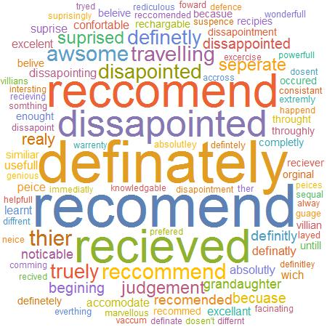
The top 100 Misspelled Words
Just searching for this sample is much better computationally than scanning for a whole dictionary and counting the words that are not in there

Slide 4
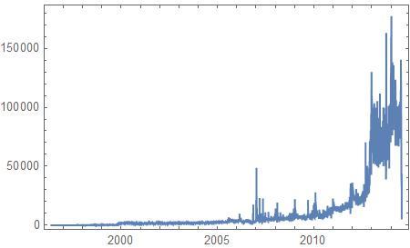
The number of reviews per day
Note the Zero entries before 2000 and after mid 2014

Slide 5
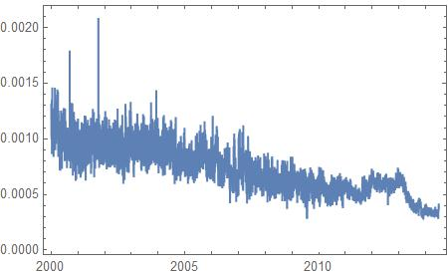
The misspelling rate data per word
Just between jan 1 2000 and jul 1 2014

Slide 6
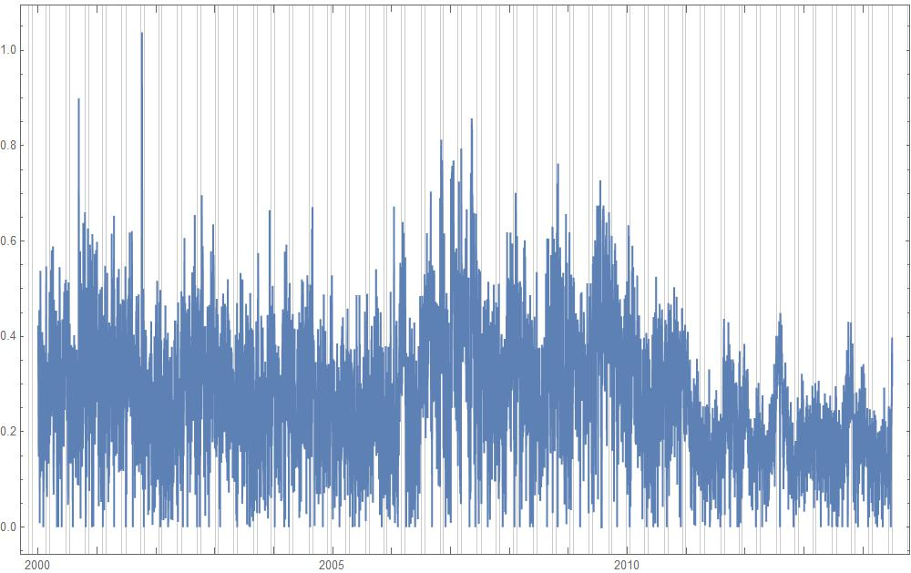
Transformed data
Through log difference from base of 30 day moving average

Slide 7
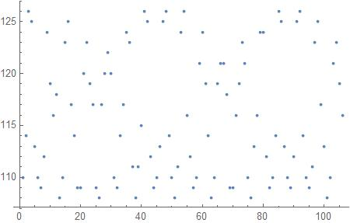
Beautiful Mercury Retrograde pattern
Note that # days in between Mercury retrogrades can be 108 to 126, so we are not looking for just one wave but the series of them

Slide 8
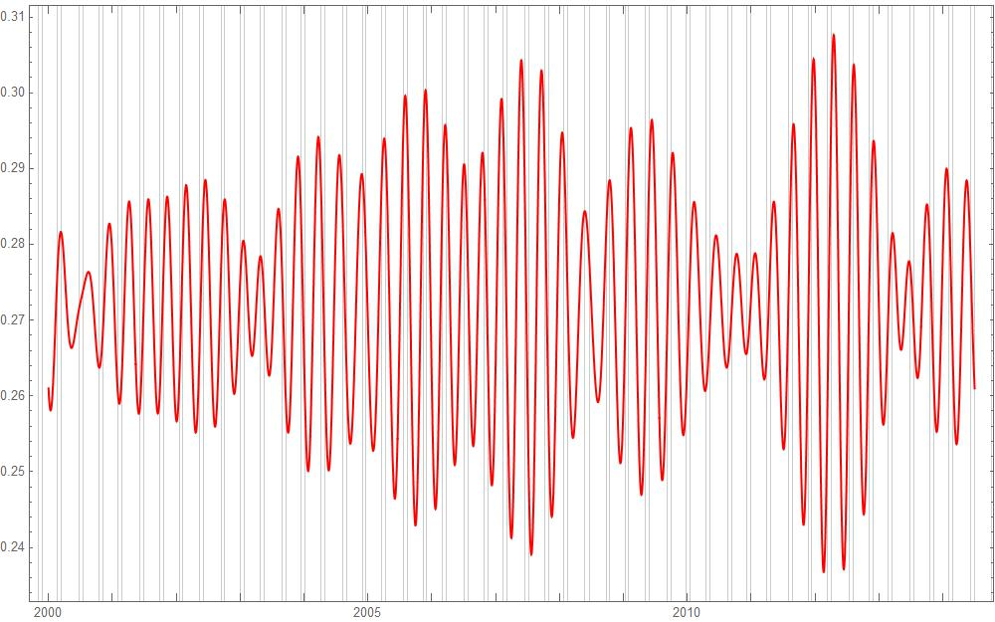
Sum of corresponding waves
Represents up to 13.2% increase OF chance to misspell per word during mercury retrograde!

Slide 9
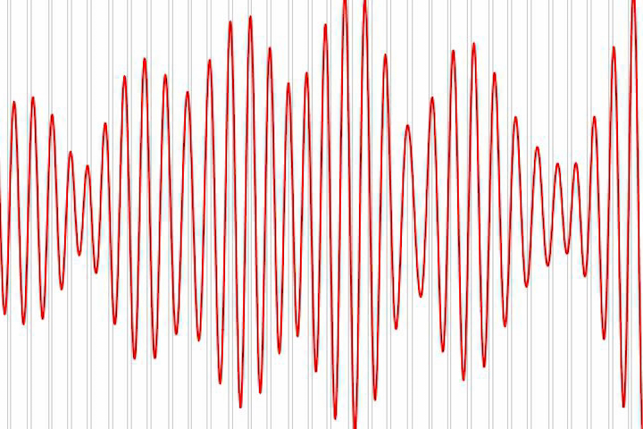
The sound of mercury retrograde (in Amazon misspelling rates), plays 3x

Slide 10
That warbling, though, suggests that mercury retrograde may be interacting with one or more other things
The reasonable next step to find out what is interacting would be to do this visual process but with bars corresponding to Sun constellation, Venus retrogression, etc. etc. etc. etc. etc.! However, there would be thousands of versions of graphs and hundreds of vertical lines on each graph!
Artificial intelligence saves the day.
What if I just feed a supercomputer all of that info?
Could it consider all of the information in a chart altogether (much like a human brain would)?

Slide 11
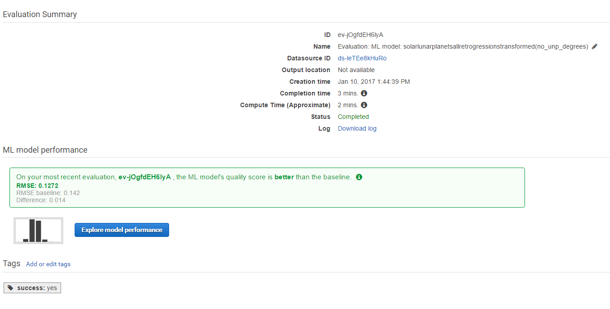
Why, yes it can!
AI Rocks! (rMSE representS average from 100x random shufflings, 30% test/70% Train, <=100 scans, MILD L2 regularization,numerical regression)

Slide 12
effects on Misspelling rate: coefficients in linear regression

Slide 13
Some more Details
Amazon machine learning supercomputer did the hands-free evaluation.
Note however that without the degrees, RMSE is no different than baseline. That is, the model performs no better than random input.
Used IAU scientific start of right ascension as 0 degrees, also known as “First Point in Aries”. This is actually in the constellation of sidereal Pisces. Does not matter. All zodiacs are just simple transformations.
Using more complex Random Forest method, average RMSE (from 100x) was reduced to 0.1189 with an average baseline of 0.1485 (a huge 20% drop).

Slide 14
Summary: Two Big Things/Firsts happened today
We saw that there is a “voice” of Mercury Retrograde in the cacophony of spelling mistakes in Amazon reviews.
We saw that artificial intelligence with just simple astronomy data as input can effectively learn to predict a complex real life phenomenon, namely likelihood of spelling mistakes in Amazon reviews.

Slide 15
Questions? Comments?
Renay Oshop
AyurAstro.com
Twitter @AyurAstro
Data and code repository is on GitHub: @renayo
I am on Facebook too.

